Slide 1
WELCOME
TO
MY PRESENTATION

Slide 2
PRESENTATION TO
MD. IMRAN HOSSAIN
Assistant Professor
Department of ICT
Comilla University
PRESENTATION BY
Kazi Mosfiqur Rahman
ID : 11709019
Department of ICT
Comilla University

Slide 3
Analog communication
Blanking and Synchronizing Pulses

Slide 4
Blanking Pulses
The composite video signal contains blanking pulses to make the retrace lines invisible by raising the signal amplitude slightly above the black level (75 per cent) during the time the scanning circuits produce retraces.
The blanking pulses:
Fig. 3.3, illustrates the composite video signal contains horizontal and vertical blanking pulses to blank the corresponding retrace intervals.
The repetition rate of horizontal blanking pulses is therefore equal to the line scanning frequency of 15625 Hz.
Similarly the frequency of the vertical blanking pulses is equal to the field-scanning frequency of 50 Hz.
The level of the blanking pulses is distinctly above the picture signal information; these are not used as sync pulses.
The sync pulses, specially designed for triggering the sweep oscillators are placed in the upper 25 per cent (75 per cent to 100 per cent of the carrier amplitude) of the video signal, and are transmitted along with the picture signal

Slide 5
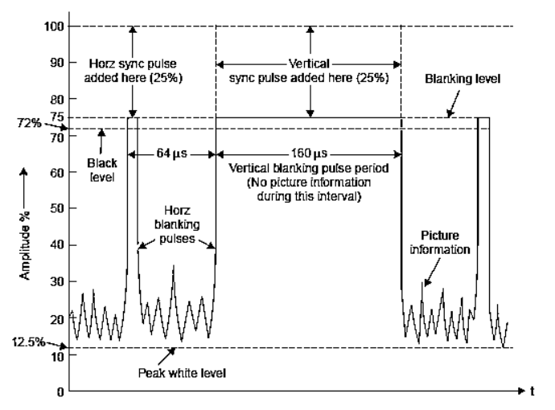

Slide 6
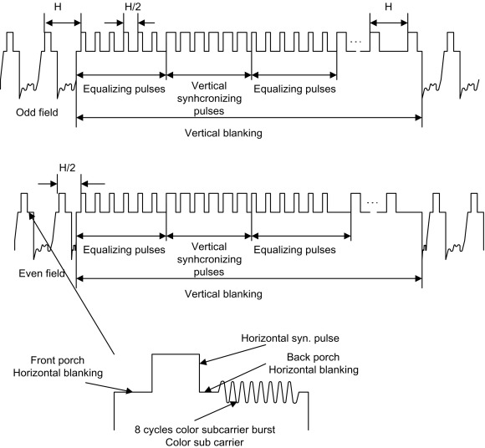
Synchronizing pulse
The synchronizing pulses are transmitted or stored along with the analog video signal for each line. These synchronizing pulses are then used to trigger the receiver's circuitry to make sure that the scene is sequenced properly on the screen

Slide 7
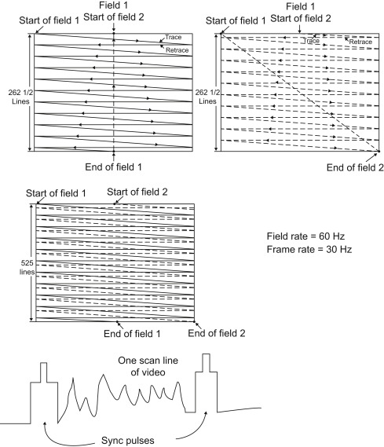
The synchronizing pulses are transmitted or stored along with the analog video signal for each line. These synchronizing pulses are then used to trigger the receiver’s circuitry to make sure that the scene is sequenced properly on the screen.
One thing that you may be wondering is how do you keep the TV receiver screen in step with the video camera or other video source? This is solved by creating synchronizing pulses that are transmitted before and after each scan line (see Fig. 11.3). After one field is scanned, a larger group of synchronizing pulses occurs between fields to cause the receiver to start the scanning back at the top again..

Slide 8
Thanks

